Slide 1

unpackAI -
Review Session

Slide 2
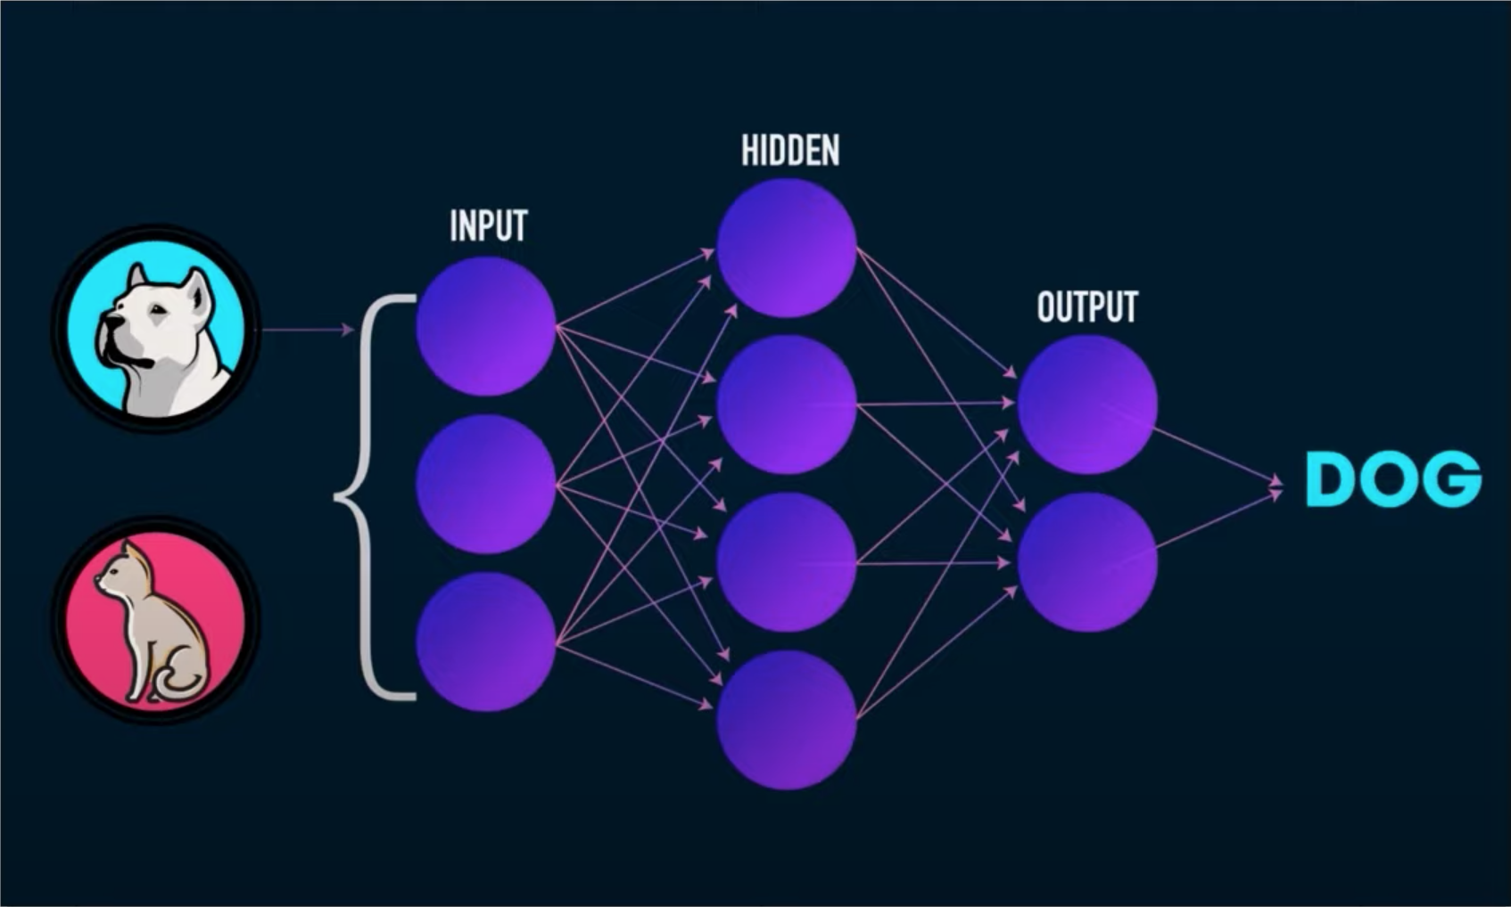
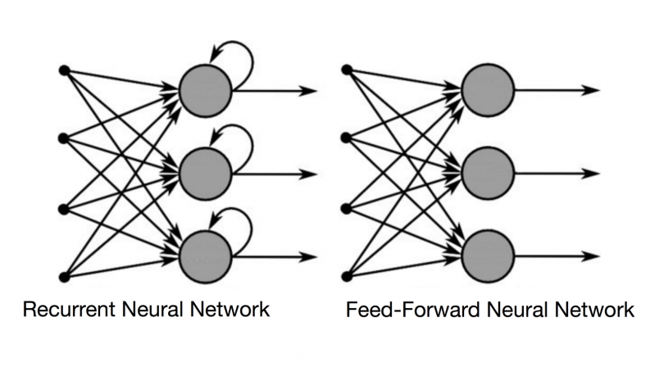
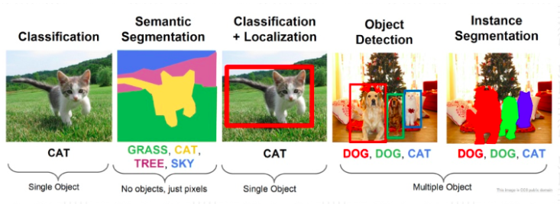
What type of neural networks have we used and learned about?
Convolutional Neural Network (CNN) is a feed forward neural network that is generally used for Image recognition and object classification.
Image Classification
Composing CNNs for complex tasks
Notes:
Only allow graduates of DL 101 to join the Slack channel to guarantee an active channel? (seems like a stupid idea but I wanted to put an online communication tool here.)

Slide 3
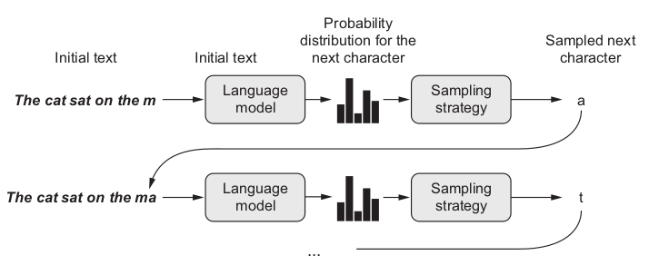
What type of neural networks have we used and learned about?
Recurrent Neural Networks (RNNs) take in sequences of data as input. Its functionality can be seen in solving NLP problems like sentiment analysis or, time series problems like sales forecasting.
RNN's can remember important things about the input they received, which allows them to be very precise in predicting what's coming next.
Character / sub-word / word
Notes:
Only allow graduates of DL 101 to join the Slack channel to guarantee an active channel? (seems like a stupid idea but I wanted to put an online communication tool here.)

Slide 4
What type of neural networks have we used and learned about?
Convolutional Neural Network (CNN) is a feed forward neural network that is generally used for Image recognition and object classification.
Recurrent Neural Networks (RNNs) take in sequences of data as input. Its functionality can be seen in solving NLP problems like sentiment analysis or, time series problems like sales forecasting.
Both require labeled data.
Notes:
Only allow graduates of DL 101 to join the Slack channel to guarantee an active channel? (seems like a stupid idea but I wanted to put an online communication tool here.)

Slide 5
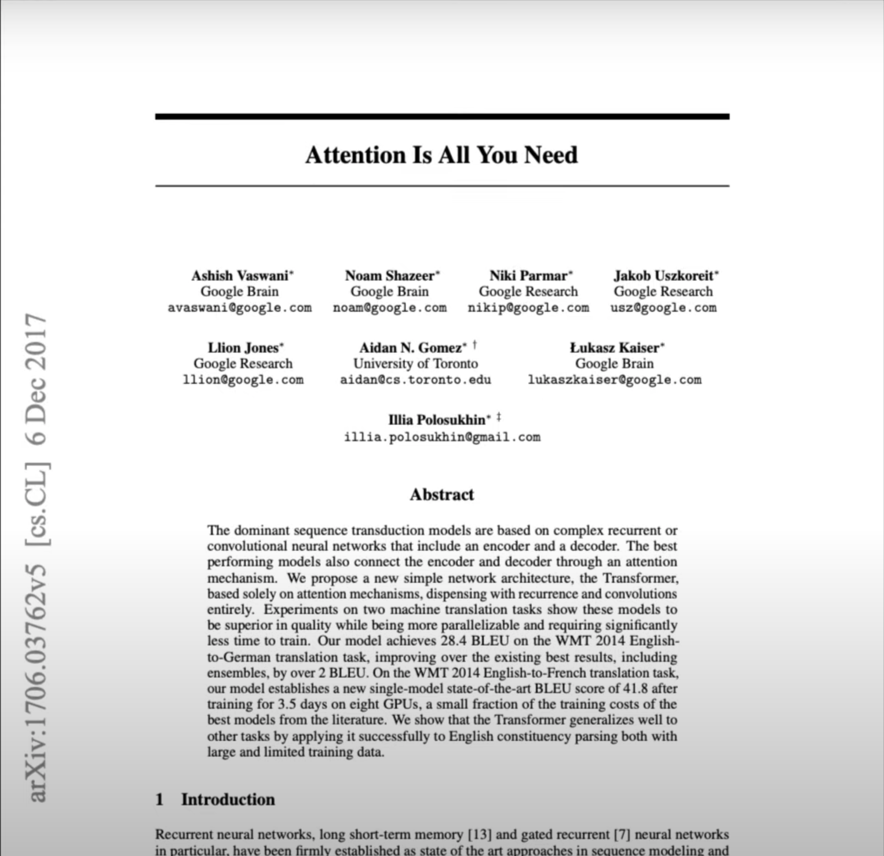
RNN vs Transformers
RNNs are slow and take too much time in training…
For RNNs, we need to feed the data sequentially or serially. One word at a time needs to be passed through the input layer. This does not make good use of GPUs.
Moreover, the further we dive into a sequence, the less the RNNs “remembers” the previous input.
Let me introduce to you Transformers!
Notes:
Only allow graduates of DL 101 to join the Slack channel to guarantee an active channel? (seems like a stupid idea but I wanted to put an online communication tool here.)

Slide 6
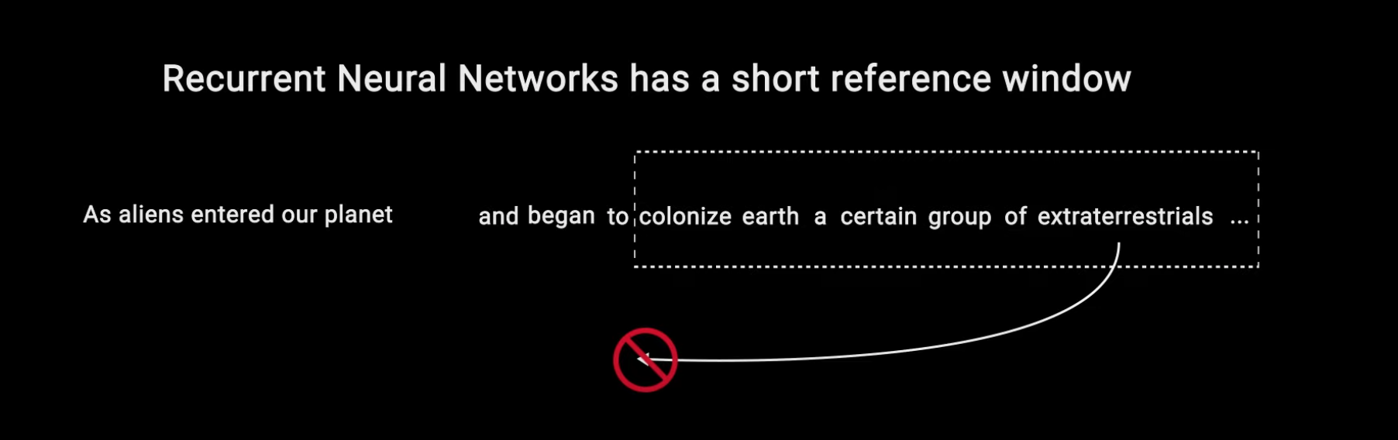
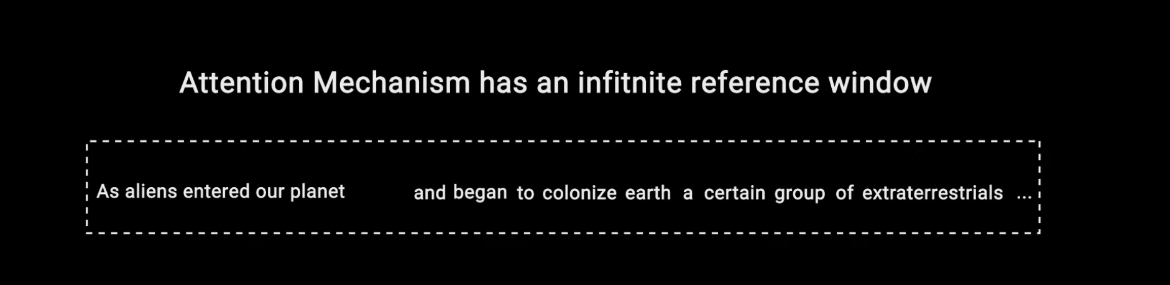
RNN vs Transformers
Notes:
Only allow graduates of DL 101 to join the Slack channel to guarantee an active channel? (seems like a stupid idea but I wanted to put an online communication tool here.)

Slide 7
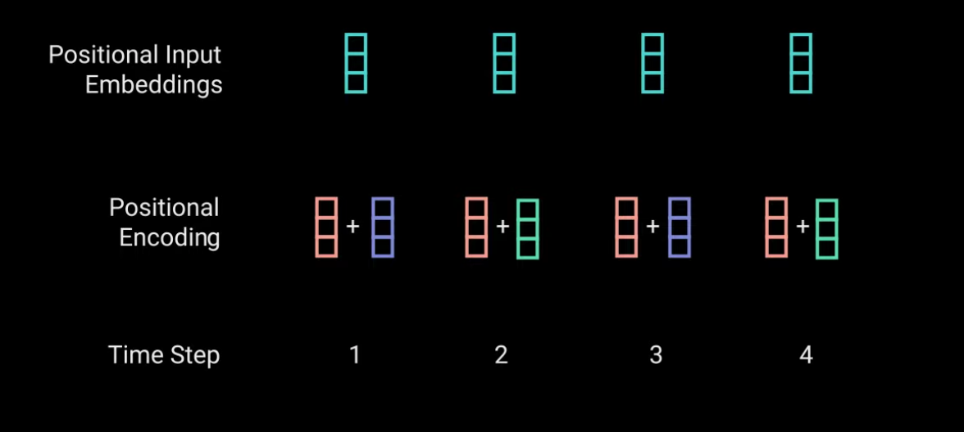
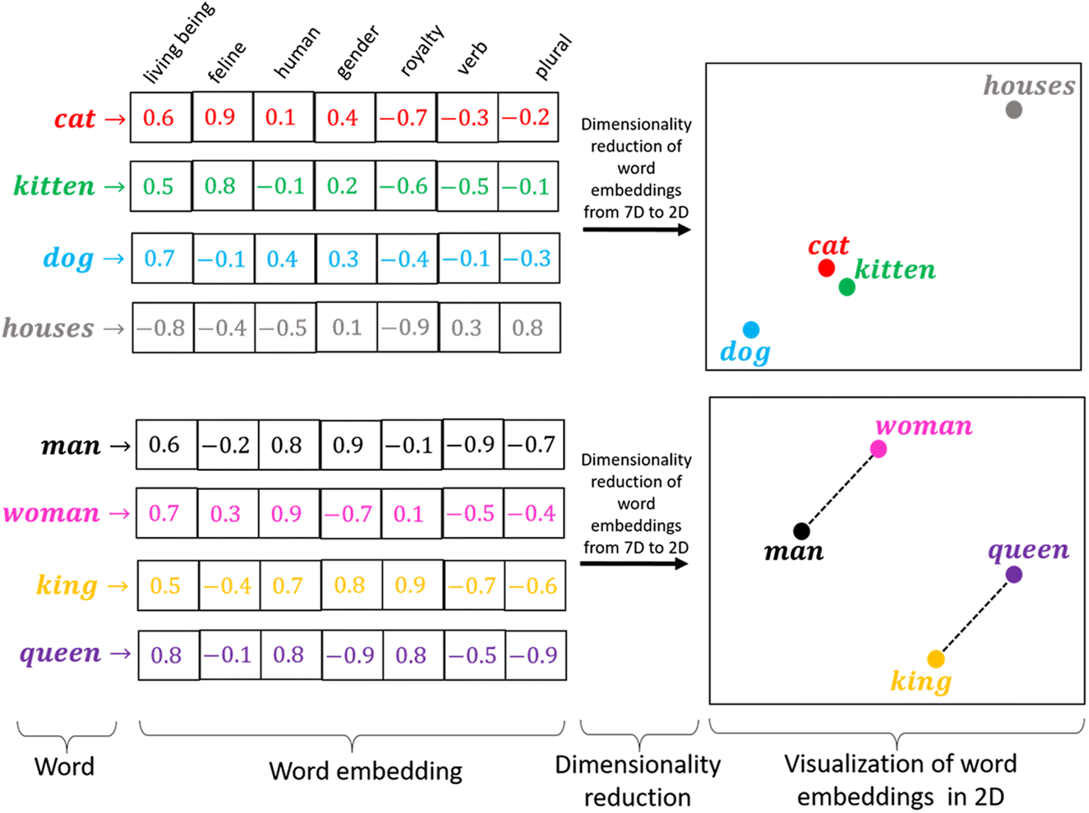
Transformers: Characteristics
1. Non sequential: sentences are processed as a whole rather than word by word.
2. Positional embeddings: another innovation introduced to replace recurrence. The idea is to use fixed or learned weights which encode information related to a specific position of a token in a sentence.
Hi, How are you?
Notes:
Only allow graduates of DL 101 to join the Slack channel to guarantee an active channel? (seems like a stupid idea but I wanted to put an online communication tool here.)

Slide 8
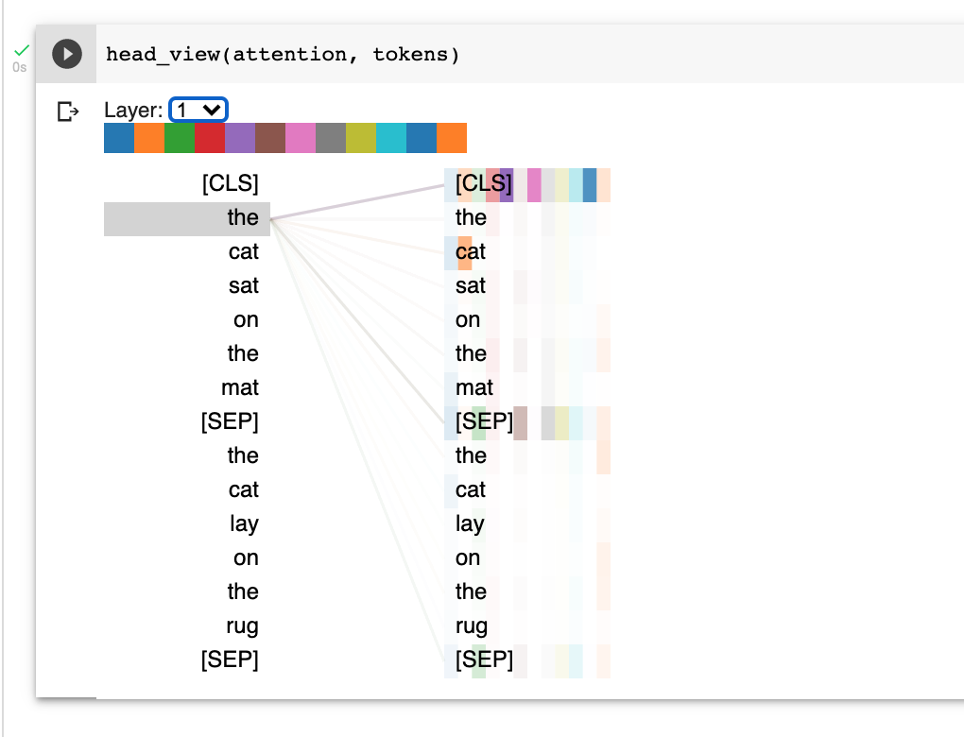
Transformers: Characteristics
3. Self Attention: this is the newly introduced 'unit' used to compute similarity scores between words in a sentence.
https://colab.research.google.com/drive/1PEHWRHrvxQvYr9NFRC-E_fr3xDq1htCj#scrollTo=M1M1TqT1ByQe
https://github.com/jessevig/bertviz
Notes:
Only allow graduates of DL 101 to join the Slack channel to guarantee an active channel? (seems like a stupid idea but I wanted to put an online communication tool here.)

Slide 9
Thanks for joining!

